Slide 1
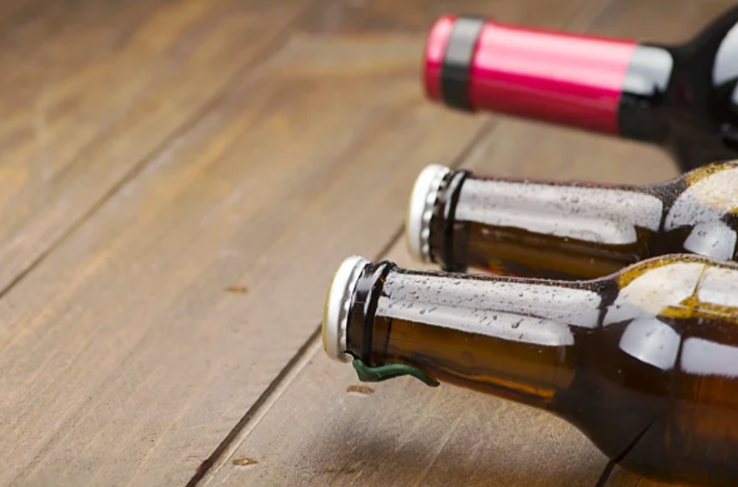
How Much Beer Do I Need to Stock? An Automated Approach to Demand Forecasting
Jenna Ford, Christian Nava & Jonathan Tan
Advisor: Dr. Bivin Sadler

Slide 2

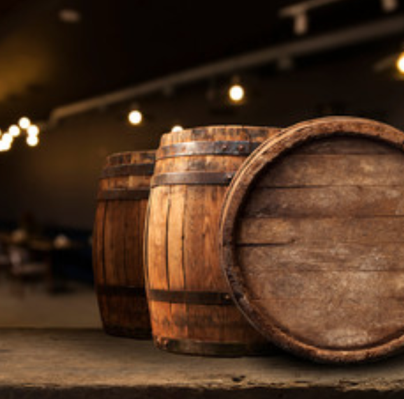
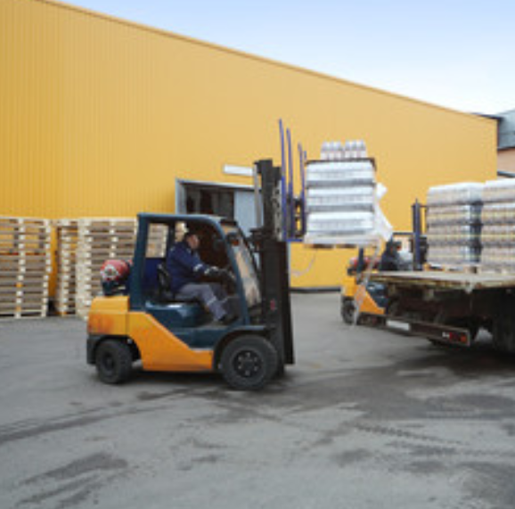
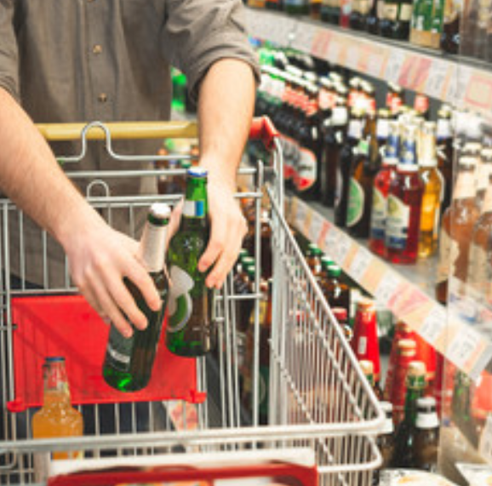

The three-tiered system
Manufacturer/
Importer
Wholesale
Distributor
Retailer
Notes:
Too much stock will go bad: distributor will have to throw it out or send it back. Cost associated with inventory.
Too little stock then you sell out and leave revenue on the table. If you can order more, costs will increase.

Slide 3
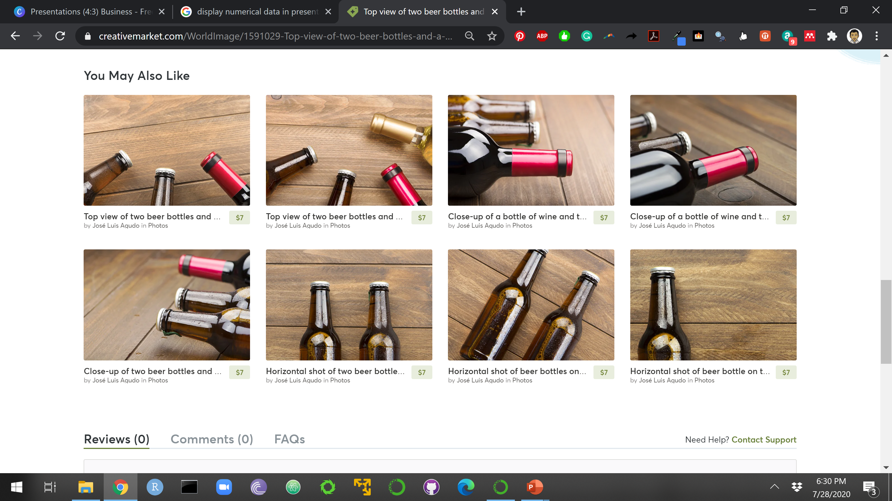
1
National wholesale alcohol distributor
Dataset
HIGH-LEVEL OVERVIEW
1
Metropolitan area
4,017
Products
34
Customers
37,391
Product/customer combinations

Slide 4




Single Analyst
Thousands of product combinations
Increase in time and costs
Increase in headcount
Notes:
One person could analyze every combination, but this is very time consuming and expensive to do.
Would require a team of people.

Slide 5

AutoML
Thousands of product combinations
Decrease in time and costs
Does not require an increase in headcount
Notes:
Forecast sales at a store/customer level to know how much product the distributor should carry in inventory.
Automated approach that will quickly identify the best model with little human intervention.

Slide 6
AutoML
Placeholder
More widespread for non time-series applications
Lit review highlights
We may need more time for results/conclusion
30 seconds

Slide 7
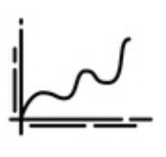

Why can’t I just do a regression?
Serially correlated data
Expensive mistake
Bad forecasts
Notes:
Will result in biased estimates of the variance, or, in other words, the errors for this time period will carry over into future time periods. In our case, an overestimate of stock this period would not be corrected in the following time period, which will turn out to be a very expensive mistake.

Slide 8
AutoML Framework
INPUT
Univariate Time Series
Record Data Characteristics
Fit Multiple Models
Make Predictions
RESULTS
Model & Predictions
Return Metrics

Slide 9
Stationarity
Image source: https://towardsdatascience.com/stationarity-in-time-series-analysis-90c94f27322
Notes:
Constant mean
Constant variance
Constant autocorrelations
Important because it’s an assumption for some models. Non-stationary data is unpredictable and cannot be reliably modeled or forecasted.
Transformations on the data can correct for this
One reason why time-series analysis is different

Slide 10


White Noise
SIGNAL
NOISE
TIME
SERIES
What we can model & predict
What we cannot predict
Notes:
If we can perfectly capture all the components that make up the signal, then the resulting residuals, or errors, would be white noise, or something we cannot predict. So, if we can prove that the model residuals are white noise, then that means the model is probably a good one and did a good job at forecasting.

Slide 11
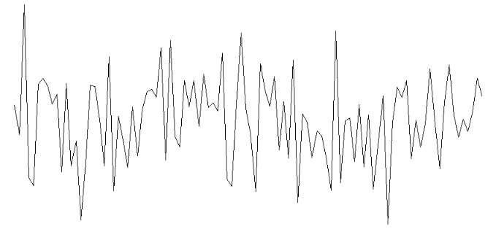
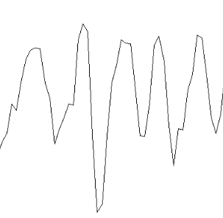
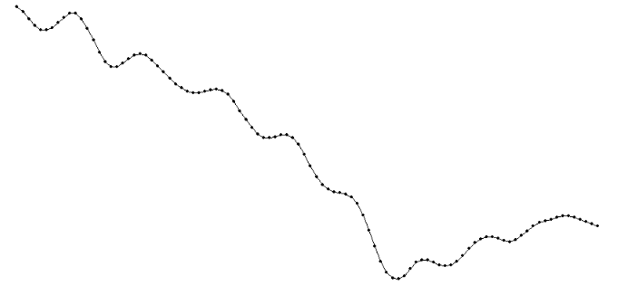
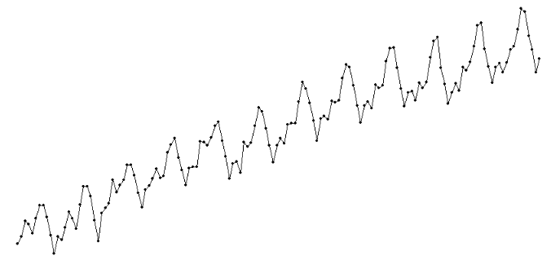
Models
Equal Means
ARMA
ARIMA, d=1
ARIMA, s=12

Slide 12
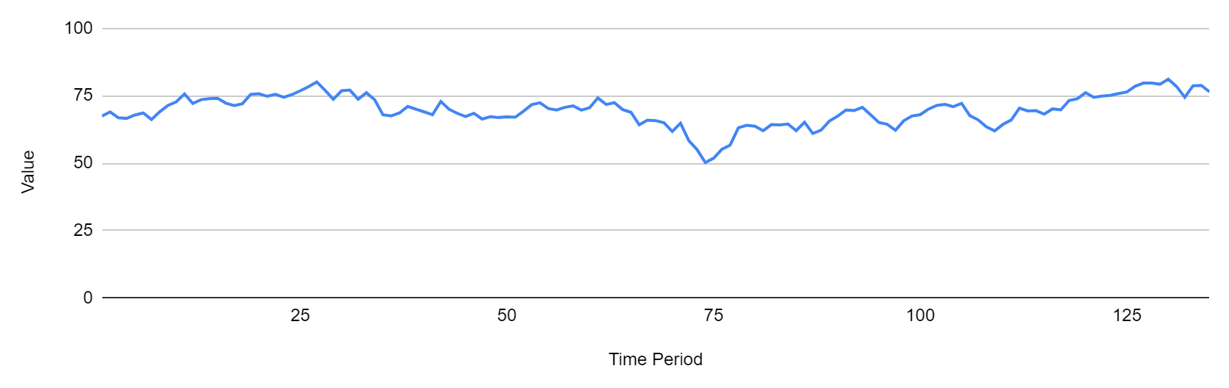
Rolling-window ASE
window
horizon
Training Set
Forecast
Dropped
Window 1
Window 2
Window 3
Window 4
Window 5
Window 6
…
…
Window n
Notes:
This slide has animations.

Slide 13
Rolling-window ASE
Notes:
This slide has animations.

Slide 14
Rolling-window ASE
Notes:
This slide has animations.

Slide 15
Rolling-window ASE
4
3
ASE
2
1
0
Notes:
This slide has animations.

Slide 16
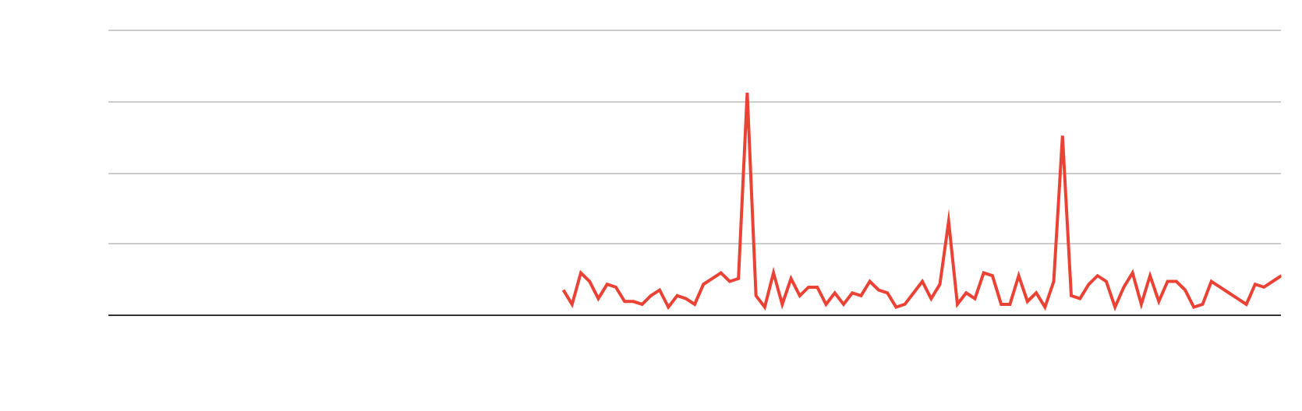
Rolling-window ASE
4
3
ASE
2
1
0
Notes:
This slide has animations.

Slide 17
Results: Not White Noise
White Noise Results | Model | Rolling-Window ASE
 |  | 3-Month Forecast | 12-Month Forecast
Not white noise | Equal Means | 7.49 | 9.07
 | ARMA | 6.44 | 6.87
 | ARIMA, d=1 | 9.90 | 9.31
 | ARIMA, s=12 | 8.66 | 9.98

Slide 18
Results: White Noise
White Noise Results | Model | Rolling-Window ASE
 |  | 3-Month Forecast | 12-Month Forecast
White noise | Equal Means | 0.74 | 0.57
 | ARMA | 0.88 | 0.75
 | ARIMA, d=1 | 0.86 | 0.72
 | ARIMA, s=12 | 1.47 | 2.18

Slide 19
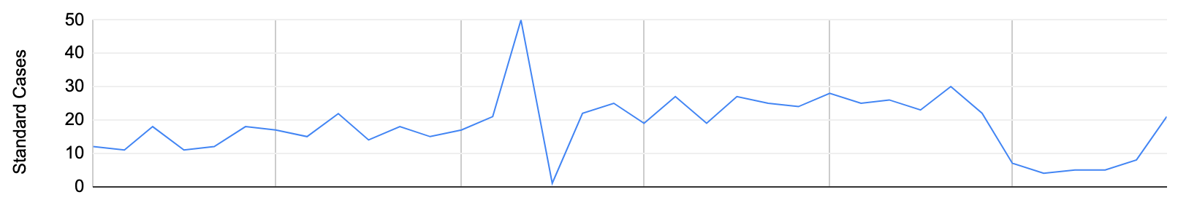

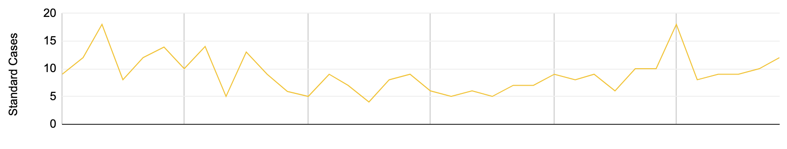
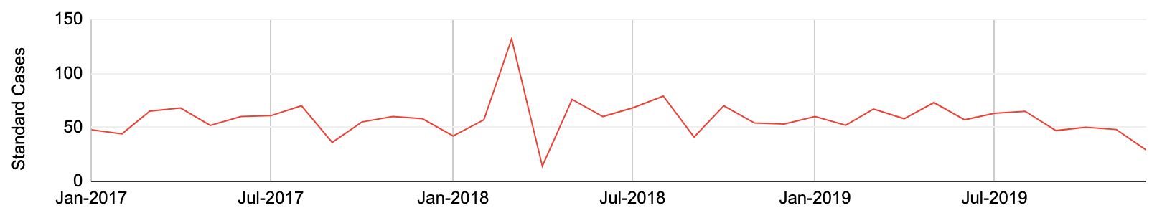
Aggregation
12-month forecast
Customer 1
(ARIMA)
Customer 2
(AR)
Customer n
(equal means)
Notes:
A forecast is generated for each customer, individually, the model that generated that forecast doesn’t necessarily have to be the same for every customer.
The resulting forecast values are then aggregated/summed to yield an overall forecast for the selected product.

Slide 20
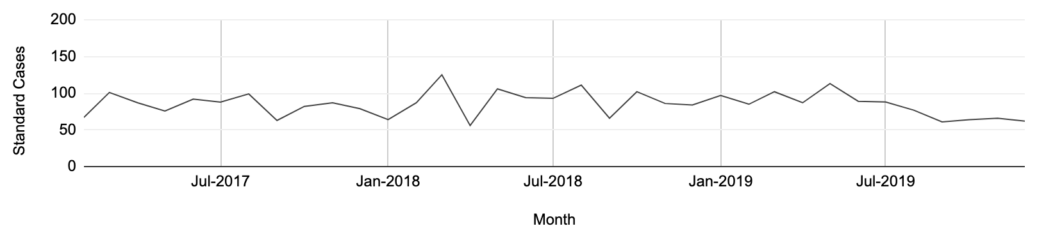
Aggregation
12-month forecast
All customers
(winning model)
Notes:
Here, a forecast in generated for all monthly customer data for the selected product . It is a single time series that aggregates all monthly standard cases for all customers.

Slide 21
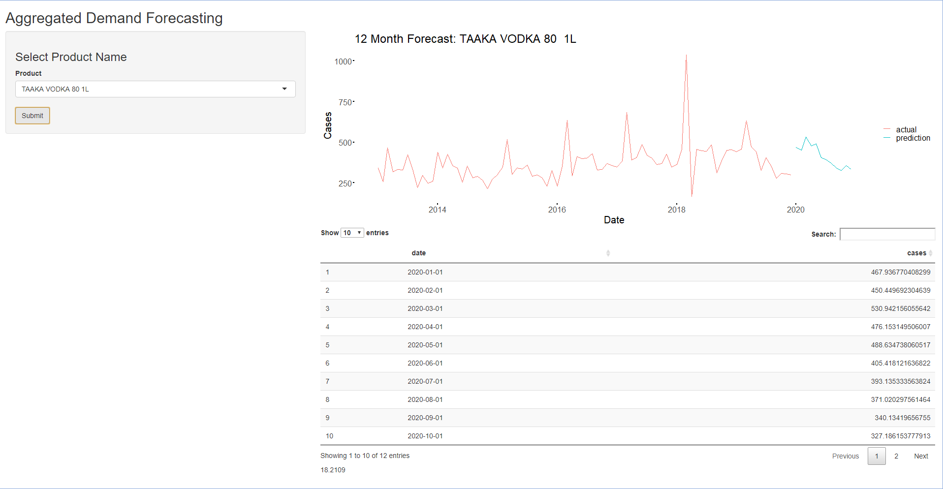
Practical Application
Notes:
Here, a forecast in generated for all monthly customer data for the selected product . It is a single time series that aggregates all monthly standard cases for all customers.

Slide 22

“
All models are wrong, but some are useful.
- George Box

Slide 23
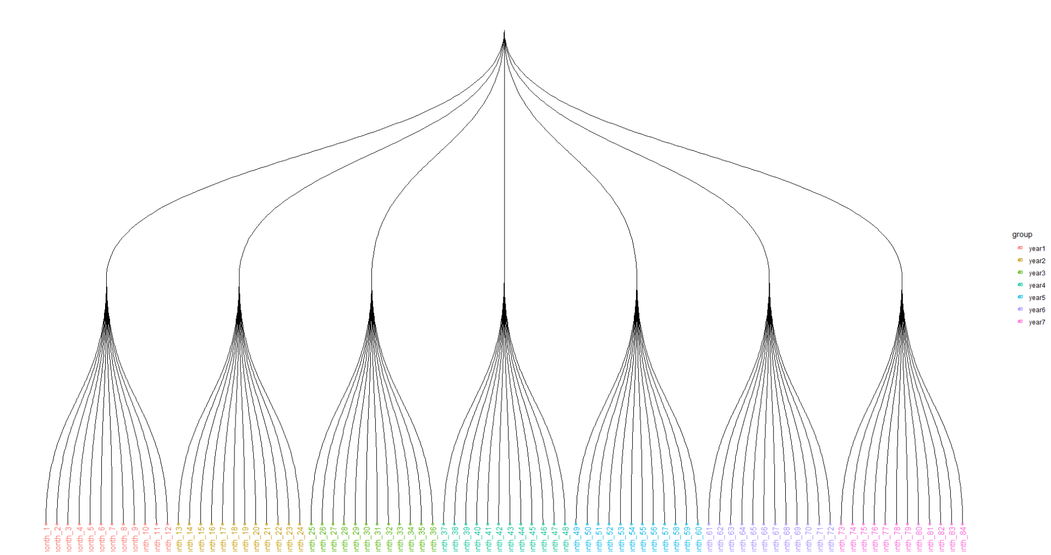
Summary
2 slides or 30 seconds
In this specific application, individual model fit per customer [worked better than] forecasting at the aggregate level.
(better predicting at bottom than top)

